Slide 1
Requirement sources and Elicitation techniques
There are a number of requirements elicitation methods. Few of them are listed below –
Questionnaires
Interviews
Observations
Prototyping
Brainstorming Sessions
Facilitated Application Specification Technique (FAST)
The success of an elicitation technique used depends on the maturity of the analyst, developers, users and the customer involved.

Slide 2
Questionnaires
To conduct the questionnaires session , the interviewer has to prepare the list of questions which should be asked via email, telephonic call, video conference or interview that’s why this technique is said to be the questionnaires.
The main strength of questionnaires is that large amounts of data can be gathered or collected from many users quickly.

Slide 3
In addition, data can be collected over a wide geographical area without incurring travel expenses.
The questionnaires are relatively inexpensive technique used for eliciting the requirements.
If the questionnaires are skillfully crafted, responses can be analyzed rapidly by computer.

Slide 4

Interviews:
Notes:
This is the most common technique used for requirement elicitation. One to one interview is the most commonly used technique.

Slide 5
Interviews:
Objective of conducting an interview is to understand the customer’s expectations from the software.
It is impossible to interview every stakeholder hence representatives from groups are selected based on their expertise and credibility.
Notes:
In this technique, the interviewer directs the question to stakeholders to obtain information.

Slide 6
Interviews:
Interviews maybe be open ended or structured.
In open ended interviews there is no pre-set agenda. Context free questions may be asked to understand the problem-unstructured
In structured interview, agenda of fairly open questions is prepared. Sometimes a proper questionnaire is designed for the interview.
Notes:
If the interviewer has a predefined set of questions then it’s called a structured interview.
Open-ended questions are used to provide detailed information

Slide 7
Interview-Basic Rules:
The overall purpose of performing the interviews should be clear.
Identify the interviewees in advance.
Interview goals should be communicated to the interviewee.
Interview questions should be prepared before the interview.
The location of the interview should be predefined.
The time limit should be described.

Slide 8
Interviews:
Benefits:
Interactive discussion with stakeholders.
The immediate follow-up to ensure the interviewer’s understanding.
Encourage participation and build relationships by establishing rapport with the stakeholder.
Drawbacks:
Time is required to plan and conduct interviews.
Commitment is required from all the participants.
Sometimes training is required to conduct effective interviews.

Slide 9
Observation
By observing users, an analyst can identify a process flow, steps, pain points and opportunities for improvement.
Observations can be passive or active (asking questions while observing).
Passive observation is better for getting feedback on a prototype (to refine requirements), where active observation is more effective at getting an understanding of an existing business process.
Either approach can be used.
Notes:
The main objective of the observation session is to understand the activity, task, tools used, and events performed by others.
During the session, the observer should record all the activities and the time taken to perform the work by others so that he/she can simulate the same.
Active observation is to ask questions and try to attempt the work that other persons are doing.
Passive observation is silent observation i.e. you sit with others and just observe how they are doing their work without interpreting them.

Slide 10
Observation
Benefits:
The observer will get a practical insight into the work.
Improvement areas can be easily identified.
Drawbacks:
Participants might get disturbed.
Participants might change their way of working during observation and the observer might not get a clear picture.
Knowledge-based activities cannot be observed.

Slide 11
Prototyping
Prototyping is a relatively modern technique for gathering requirements. In this approach, you gather preliminary requirements that you use to build an initial version of the solution - a prototype. You show this to the client, who then gives you additional requirements. You change the application and cycle around with the client again. This repetitive process continues until the product meets the critical mass of business needs or for an agreed number of iterations
Notes:
Prototyping is used to identify missing or unspecified requirements. In this technique, frequent demos are given to the client by creating the prototypes so that client can get an idea of how the product will look like. Prototypes can be used to create a mock-up of sites, and describe the process using diagrams.

Slide 12


Slide 13
Prototyping
Benefits:
Gives a visual representation of the product.
Stakeholders can provide feedback early.
Drawbacks:
If the system or process is highly complex, the prototyping process may become time-consuming.
Stakeholders may focus on the design specifications of the solution rather than the requirements that any solution must address.

Slide 14
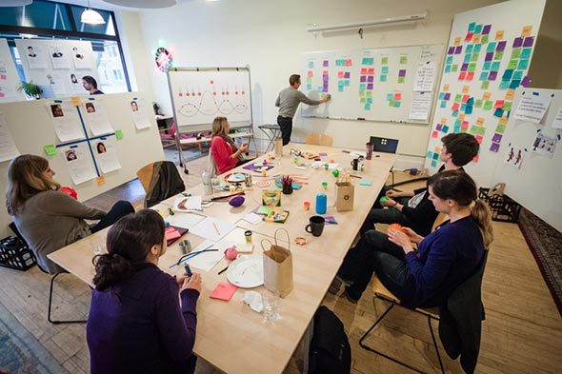
Brainstorming Sessions

Slide 15
Brainstorming Sessions
It is a group technique
It is intended to generate lots of new ideas hence providing a platform to share views
A highly trained facilitator is required to handle group bias and group conflicts.
Every idea is documented so that everyone can see it.
Finally a document is prepared which consists of the list of requirements and their priority if possible.
Notes:
This technique is used to generate new ideas and find a solution for a specific issue. The members included for brainstorming can be domain experts, subject matter experts. Multiple ideas and information give you a repository of knowledge and you can choose from different ideas.
This session is generally conducted around the table discussion. All participants should be given an equal amount of time to express their ideas

Slide 16
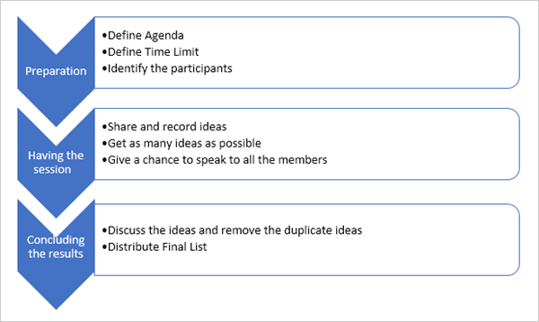
Brainstorming Phases
Notes:
Brainstorming technique is used to answer the below questions:
What is the expectation of a system?
What are the risk factors that affect the proposed system development and what to do to avoid that?
What are the business and organization rules required to follow?
What are the options available to resolve the current issues?
What should we do so that this particular issue does not happen in the future?

Slide 17
Brainstorming Sessions
Basic rules for this technique which should be followed to make it a success:
The time limit for the session should be predefined.
Identify the participants in advance. One should include 6-8 members for the session.
The agenda should be clear enough for all the participants.
Clear expectations should be set with the participants.
Once you get all the information, combine the ideas, and remove the duplicate ideas.
Once the final list is ready, distribute it among other parties.
Notes:
Benefits:
Creative thinking is the result of the brainstorming session.
Plenty of ideas in a short time.
Promotes equal participation.
Drawbacks:
Participants can be involved in debating ideas.
There can be multiple duplicate ideas.

Slide 18
Brainstorming Sessions
Benefits:
Creative thinking is the result of the brainstorming session.
Plenty of ideas in a short time.
Promotes equal participation.
Drawbacks:
Participants can be involved in debating ideas.
There can be multiple duplicate ideas.
Notes:
Some participants are more quiet and don't like to speak spontaneously in groups. Other participants speak too much.
Some participants need longer to understand the theme and can't immediately provide ideas

